Slide 1
Processing with Python
Programming an epidemic simulator

Slide 2
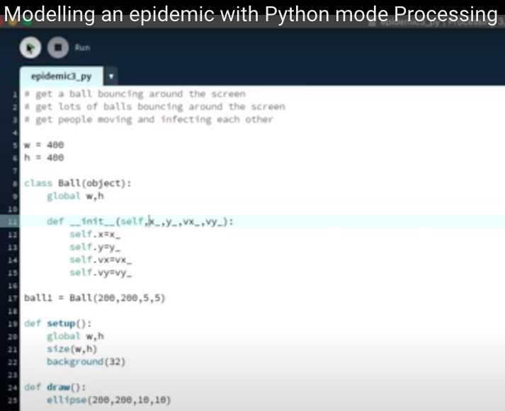
Creating an object
Declaration
Global variable
Class definition

Slide 3
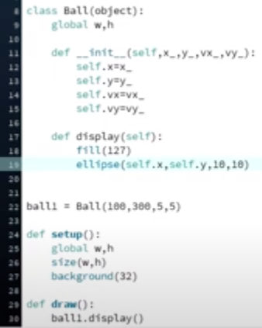
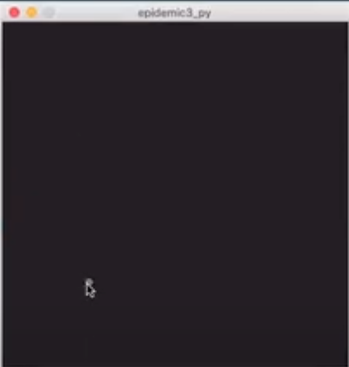
Creating an Instance
Assignment
Dot notation

Slide 4
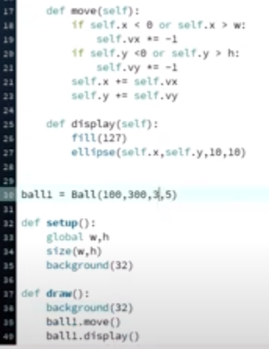
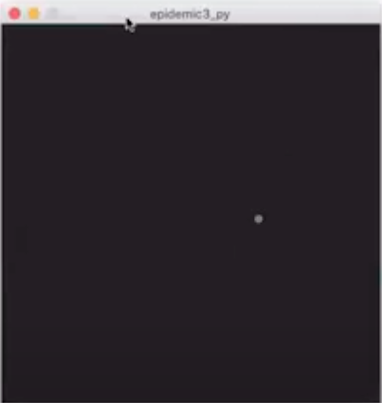
Move the ball
If Conditional statements

Slide 5
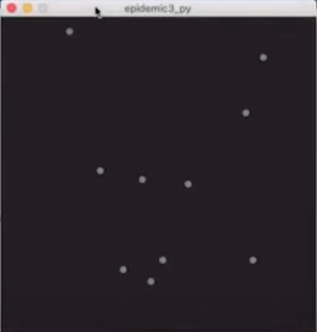
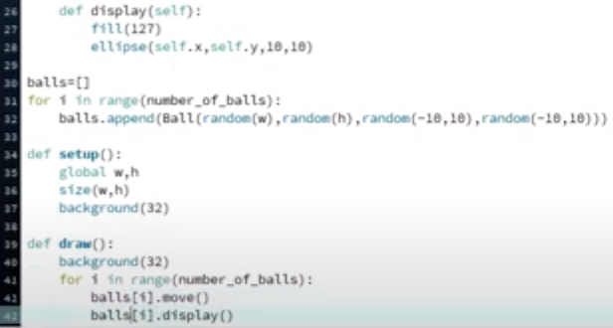
Make more balls
Add this to the declaration- number_of_balls = 10
Parameters for a ball

Slide 6

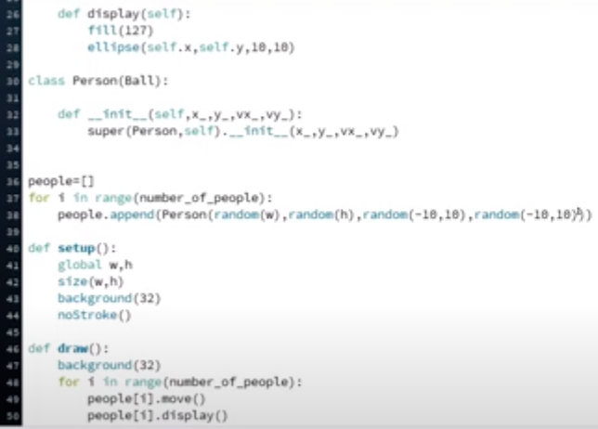

Now make people
Inheritance
Array of people
Loop

Slide 7
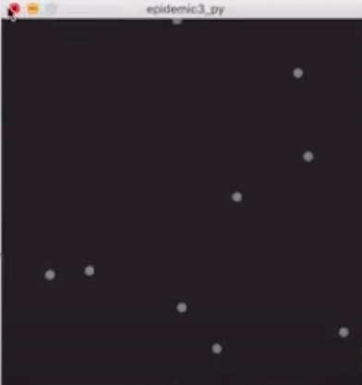

Give ID and Status

Slide 8
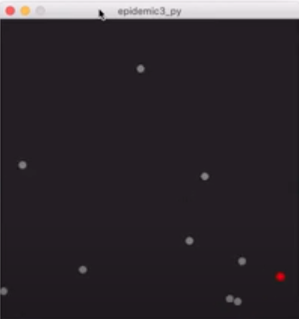
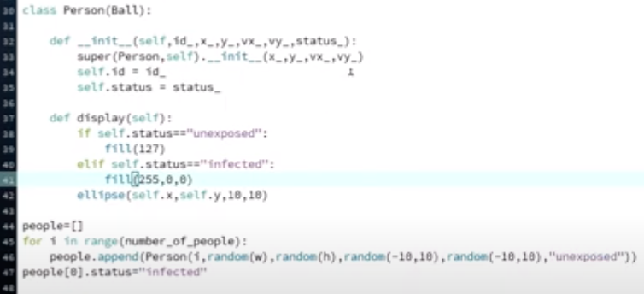
Infect person zero
Test == equality

Slide 9
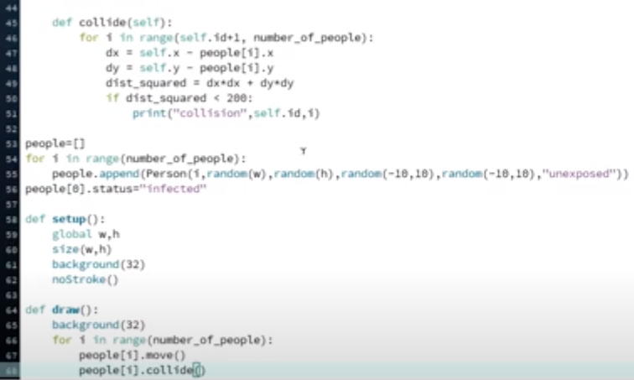
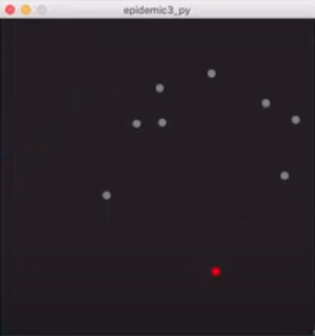
Collisions
Print method outputs to the console

Slide 10
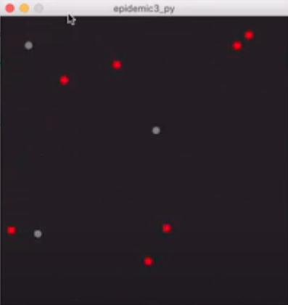

Epidemic
Conditional to change status

Slide 11
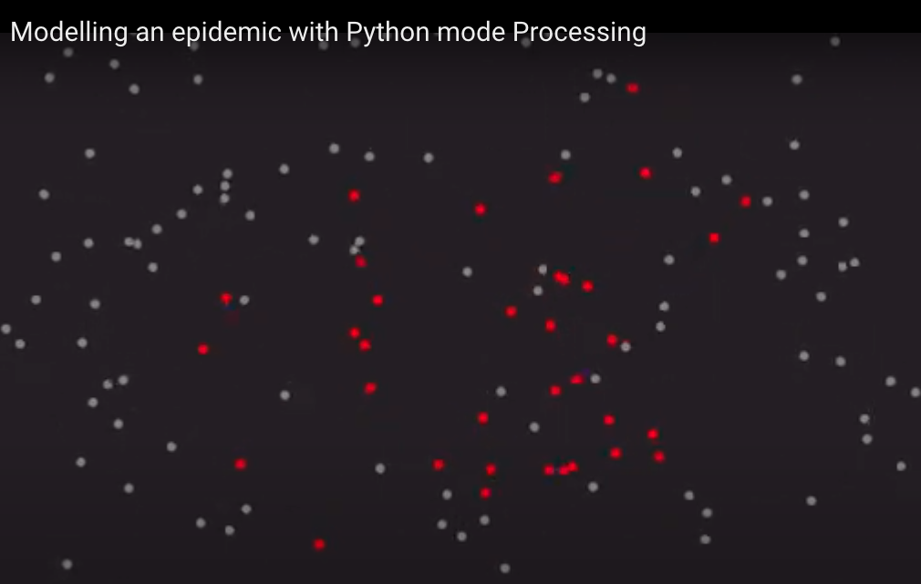
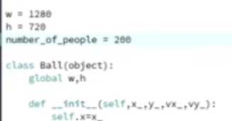
Play with numbers

